Slide 1
ELECTRIC VEHICLES AND THEIR IMPACT ON THE ENVIRONMENT
Team Pewter

Slide 2
Table of Contents
TEAM MEMBERS
Wen Chiou
Jason Hanlin
Camilla Inhapim
Marlon Ruiz
Matthew Copello
Fatima Mumin
Sami Kolahdoozan
Toyin Olaye
Doug Hooper
Ershad Ziaei
EV Growth vs Oil Displacement
EV Cars in the U.S.
Traditional Vehicle Dataset
EV Fuel Efficiency Dataset
Estimated C02 Emissions & MPG of EVs over time
Traditional vehicles vs. EVs
Environmental Impact from Electric Vehicles from Lithium Demand
CO2 Emissions for Non-Electric Cars

Slide 3
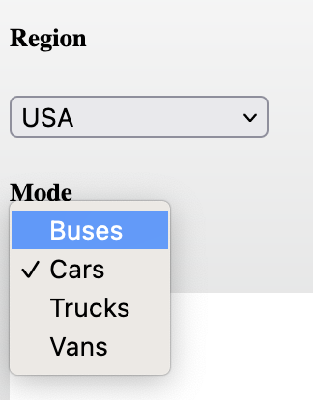
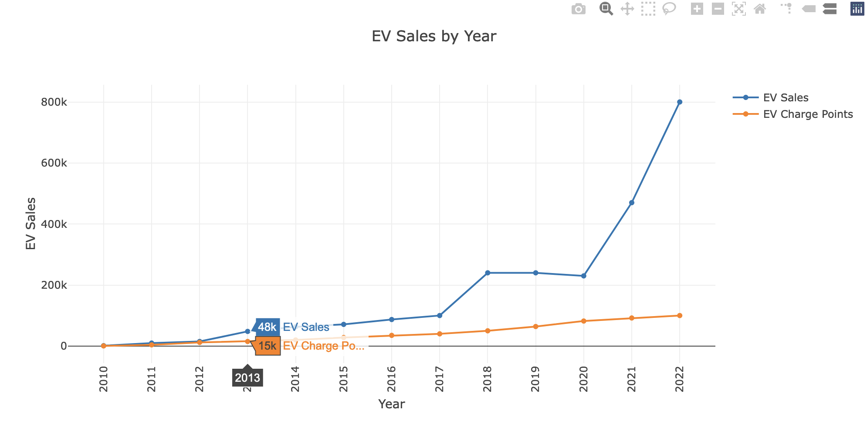
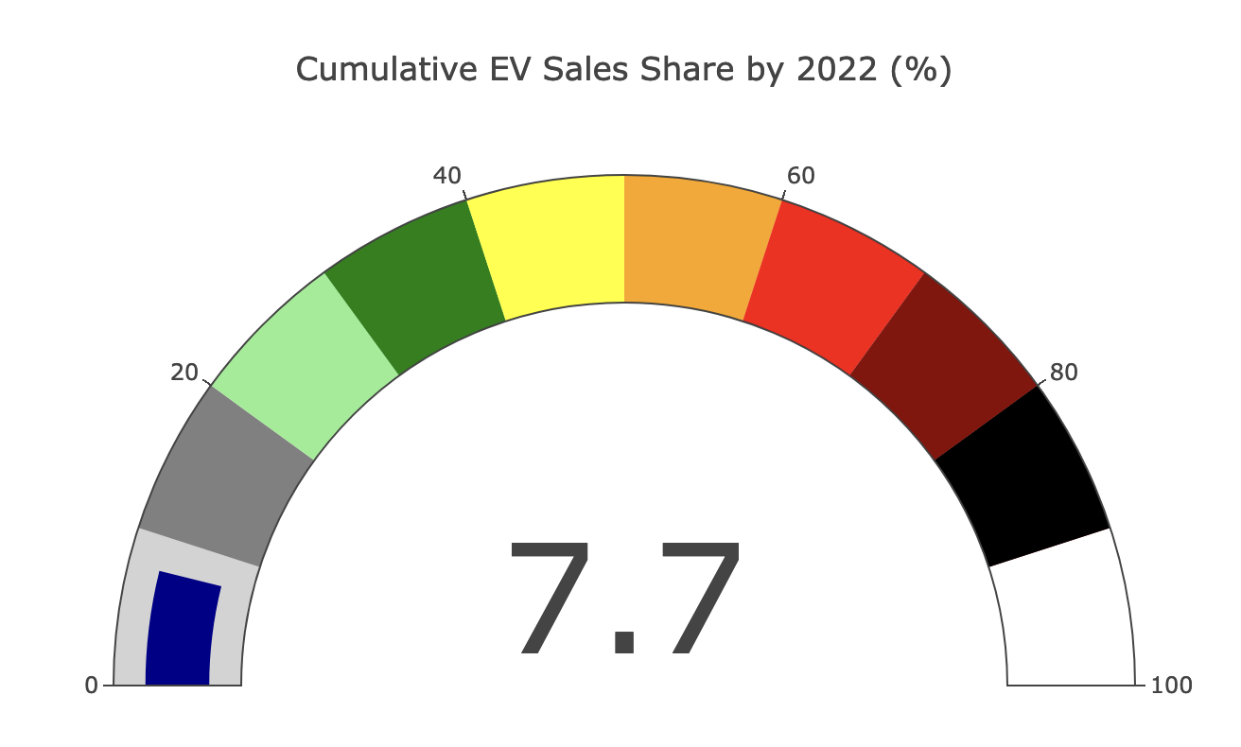
EV Growth vs Oil Displacement
Data sourced from International Energy Agency (https://www.iea.org/data-and-statistics/data-sets)
Included over 10,000 records from 2010 to 2022
Included parameters for electric vehicles and charging stations related to vehicle type (bus, car, truck, vans) and region (country, world, and continent).
Results included metrics such as electricity demand, EV sales, EV sales share, chargepoints, ev stock, and oil displacement.
Dashboard created using HTML and JavaScript using csv output from source site.
Interactive dropdowns for Region and Mode (vehicle type) control output for EV Sales by Year plot, EV Sales Share in 2022 gauge plot, and the Oil Displacement plot. Allows for user investigation and comparison of EV sales versus oil displacement for a given region and vehicle type on the same dashboard.
Hot tip: creating a quick pivot chart in excel was helpful to evaluate the data and its contents
Notes:
Jason’s slide

Slide 4
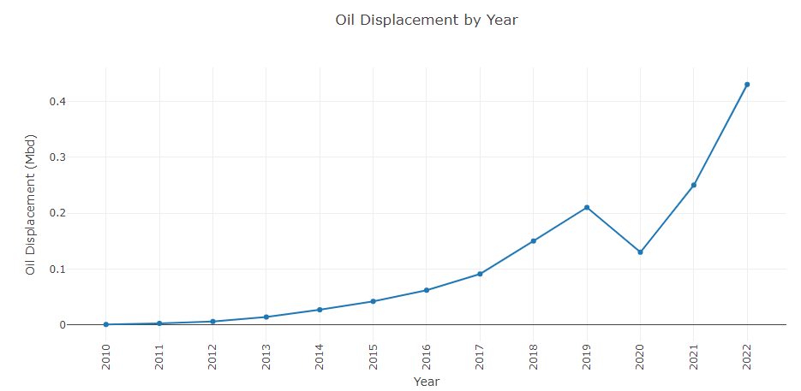
Oil Displacement
Oil displacement: the replacement of petroleum-based transportation fuels (gasoline and diesel) with electricity.
Electric Vehicles (EV) have the potential to reduce greenhouse gas emissions associated with the production and use of petroleum-based fuels.

Slide 5
EV Cars in the U.S.
Data Source: U.S. Department of Energy - The Office of Energy Efficiency and Renewable Energy (EERE)
Data Collection: Data scraping, and jsonify csv files
Available data: EV cars sold, and number of charging outlets for the period of 2016-2021
Visualizing data:
Drop-down list for different states
Number of EV cars sold vs. all sold cars
Number of EV cars sold vs. number of charging outlets

Slide 6
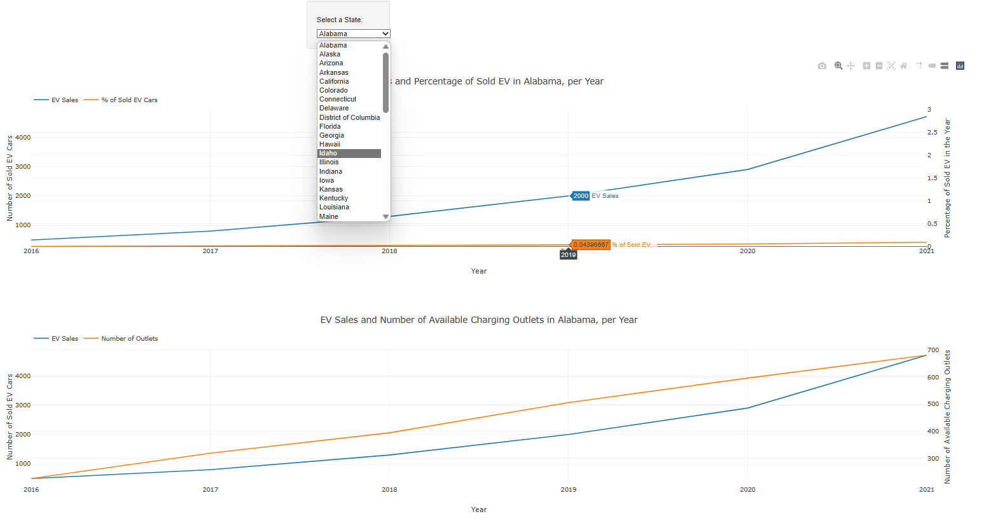
EV Cars in the U.S.

Slide 7
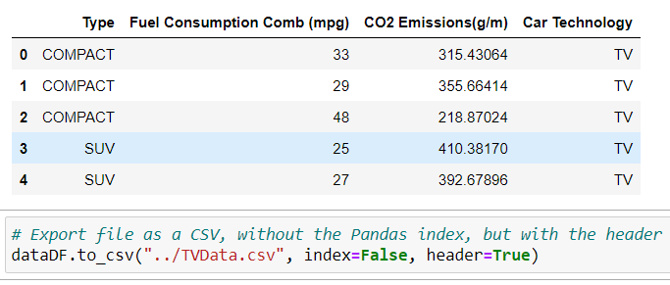
Traditional Vehicle Dataset
Used Python and Pandas to transform the source data.
Fuel Consumption - City and highway fuel consumption ratings are shown in litres per 100 kilometres (L/100 km) - the combined rating (55% city, 45% hwy) is shown in L/100 km and in miles per gallon (mpg)
CO2 Emissions - The tailpipe emissions of carbon dioxide (in grams per kilometre) for combined city and highway driving
The combined fuel consumption (55% city, 45% highway)
Create a dataframe from a CSV file containing data from 2013-2020
Manipulate dataframe by renaming, dropping unnecessary columns, and converting units to align with Electric Vehicle dataset
Data Source: compiled dataset from Kaggle
(source: open.canada.ca)

Slide 8
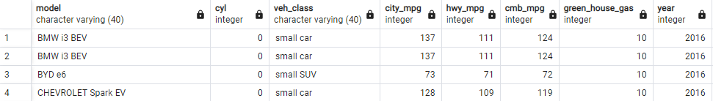
EV Fuel Efficiency Dataset
EV Fuel Economy data was collected from:
The Laboratory of Environmental Protection Agency’s National Vehicle and Fuel Emissions in Ann Arbor Michigan
Used Python and Pandas to transform the source data.
•Create a dataframe from CSV files representing each year from 2016 - 2022.
Data Source: fueleconomy.gov

Slide 9
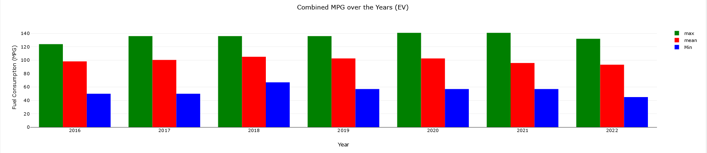
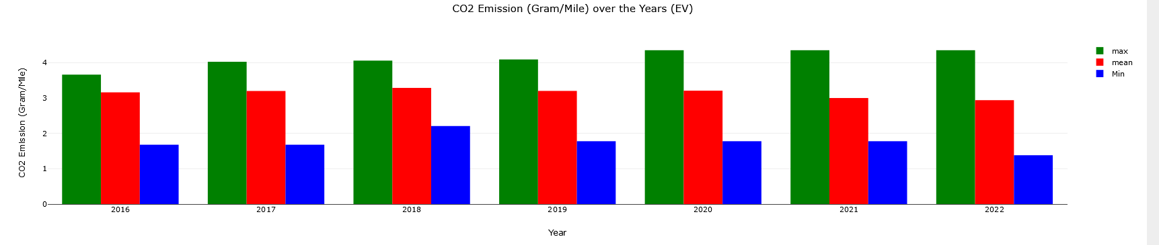
Estimated C02 Emissions & MPG of EVs over time
We used estimated values for CO2 emissions of EVs through this equation:
EV CO2 emissions = ((MPG/(33.7))/0.9)
33.7 => is the equivalent kwH in a gallon of gasoline
0.9 => accounts for the 90% energy efficiency of EVs

Slide 10
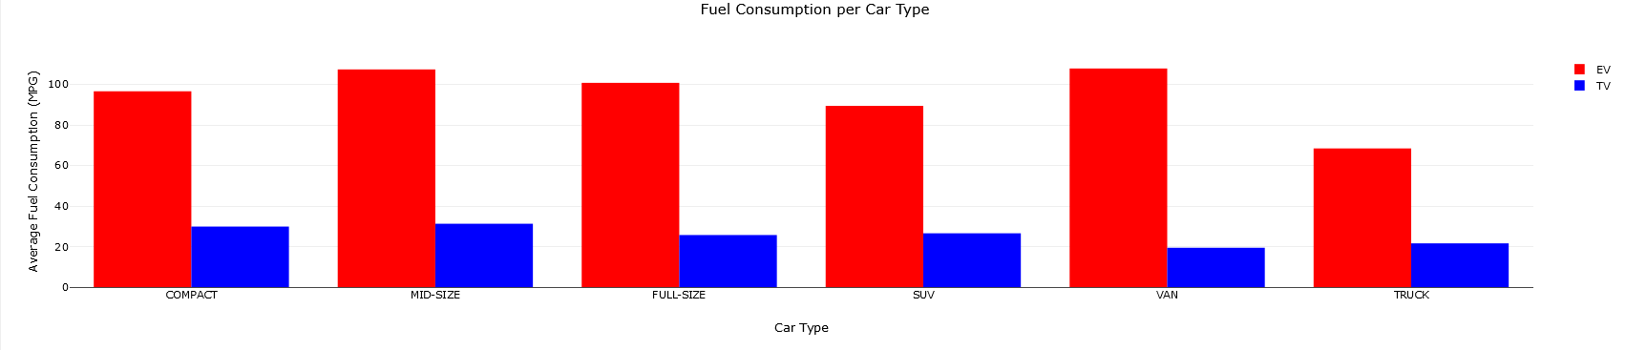
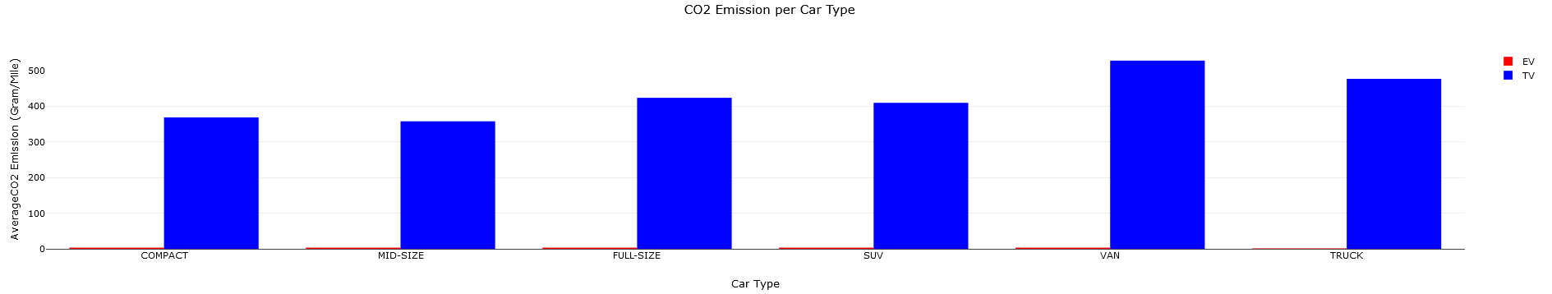
Traditional vehicles vs. EVs
The same estimated values for CO2 emissions were used here
EV’s miles per kWh were converted to MPG by the researchers
These two graphs demonstrate the dramatic comparison between the two vehicles

Slide 11
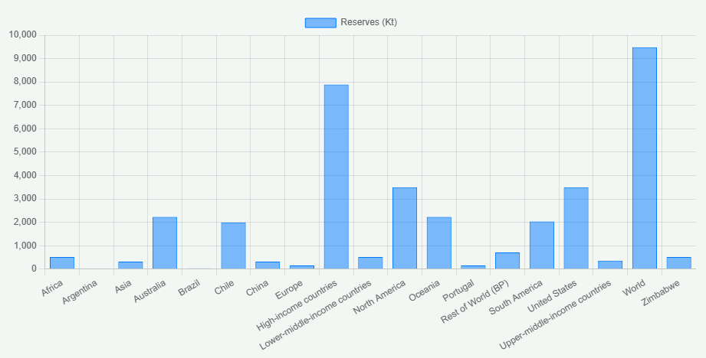
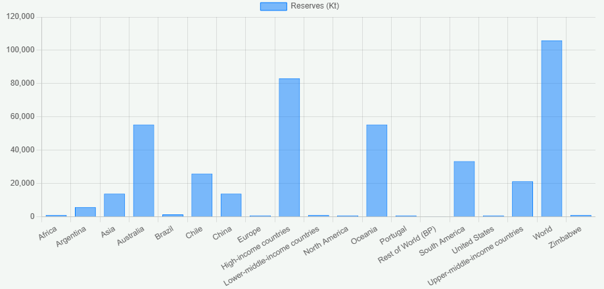
Environmental Impact from Electric Vehicles (Lithium Demand)
***Chart.js; Node.js; JSON Fetch

Slide 12

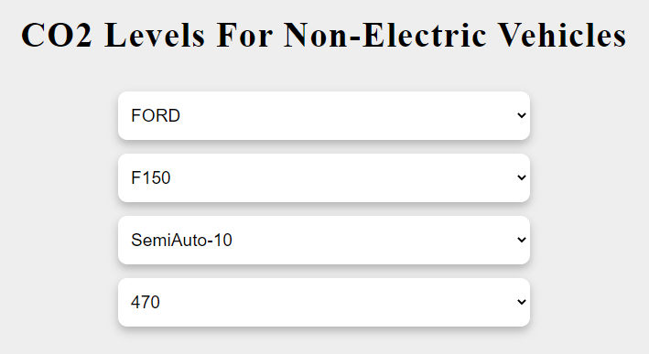
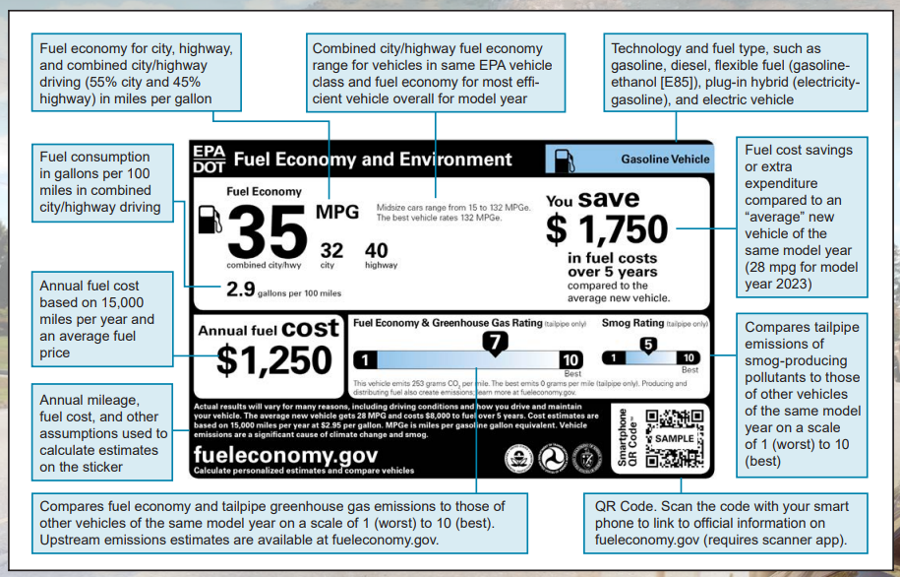
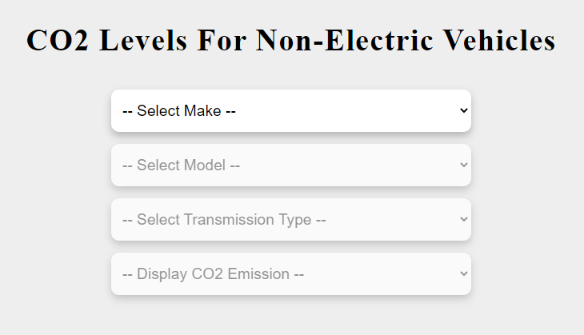
CO2 Emissions for Non-Electric Cars
How can you find your vehicle's CO2 (gram per mile) emissions?
Carbon footprint is in fineprint
(grams/mile)

Slide 13
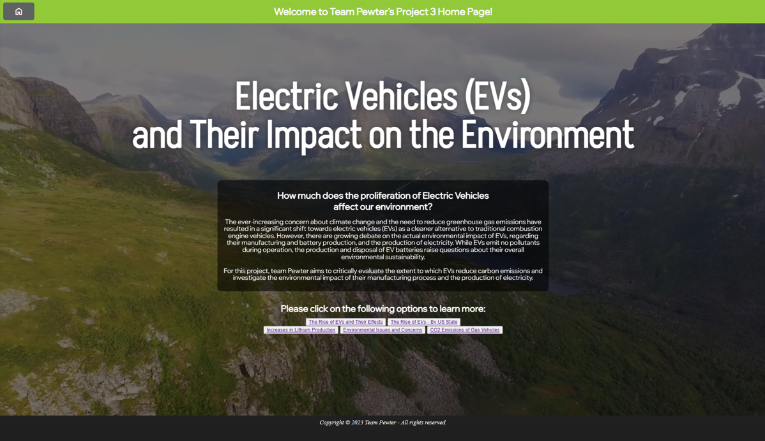
Live Server Website

Slide 14
Final Thoughts

Slide 15
THANK YOU!

Slide 16
REFERENCE

